Slide 1
Mass Media. What’s the news? Prepared a presentation Teacher of English Anisova Julia Vladimirovna

Slide 2
Mass Media play an important part in our life. Newspaper, radio and especially TV inform us what is going in the world and give us wonderful possibilities for education.

Slide 3
MASS MEDIA
TV
Radio
Internet
Newspapers
Magazines

Slide 4
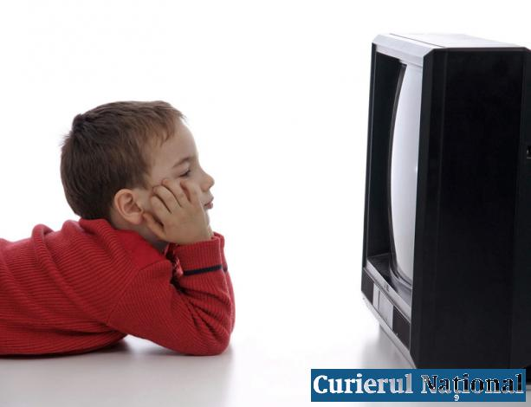
Television plays a big role in our society and a lot of people prefer watching TV to reading a newspaper. Television provides a great opportunity for people to learn latest news, watch educational programmes, children’s programmes, old and new films, soup operas and TV-series.

Slide 5
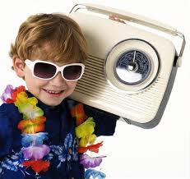
Radio is less popular than newspapers and television but still people listen to it in cars or at work. Every hour stations tell latest news in brief. There are also different types of radio stations and one can find any radio station to their liking.

Slide 6
The Internet is the newest kind of mass media but which has become the most popular and greatest source of information and entertainment. If you have the internet access, you may read newspapers online, watch films, listen to music, listen to radio and even watch television online!

Slide 7
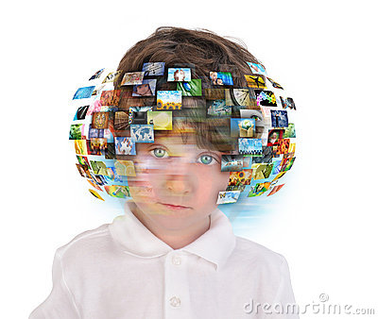
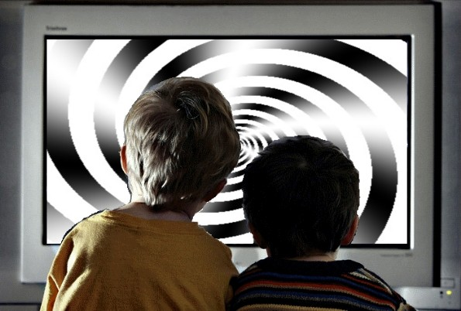
Surely, there are advantages and disadvantages of mass media. Some of the advantages are education and entertainment. However, one needs to have special equipment, like a TV- set to watch television, a radio-set to listen to the radio or a computer with the internet access to surf the Net and buying all of these may be hard if one doesn’t have enough money. Another disadvantage is that sometimes the information which is provided on the Internet is unreliable and may even be harmful to people.

